Slide 1
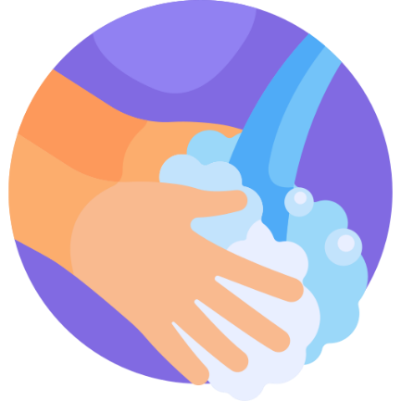
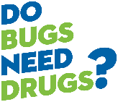

Hand Hygiene 101
Healthy Living through Health Promotion
2025

Slide 2


Let’s start with a game!
I will ask some questions:
Give a thumbs up if you think the statement is true
Give a thumbs down if you think the statement is false
Notes:
We will go through 5 true or false questions and you can give your best guess if the statement is true or false. If you think it is true, give a thumbs up, if you think it is false, give a thumbs down.

Slide 3
Question 1
True/False Questions
Handwashing with warm water is the same as using soap and water.
Thumbs up for TRUE
Thumbs down for FALSE
Notes:
Read the question aloud to the participants. Remind participants to use thumbs up if they think it’s true and thumbs down if they think it is false.
The answer will appear when you click the mouse or right arrow on the keyboard.

Slide 4
Question 1
True/False Questions
Handwashing with warm water is the same as using soap and water.
Answer
False: Handwashing with soap is needed to effectively clean hands. Plain soap and water are the best way to stop the spread of infections.
Thumbs up for TRUE
Thumbs down for FALSE
Notes:
Read the question aloud to the participants. Remind participants to use thumbs up if they think it’s true and thumbs down if they think it is false.
The answer will appear when you click the mouse or right arrow on the keyboard.

Slide 5
Question 2
True/False Questions
Drying your hands with paper towels or clean hand towels after handwashing removes more germs than handwashing alone.
Thumbs up for TRUE
Thumbs down for FALSE
Notes:
Read the question aloud to the participants. Remind participants to use thumbs up if they think it’s true and thumbs down if they think it is false.
The answer will appear when you click the mouse or right arrow on the keyboard.

Slide 6
Question 2
True/False Questions
Drying your hands with paper towels or clean hand towels after handwashing removes more germs than handwashing alone.
Answer
True: The friction of drying your hands on a paper towel or clean hand towel removes more germs than handwashing alone. Also, wet hands pick up more germs from surfaces than dry hands, so it is very important to dry your hands after handwashing.
Thumbs up for TRUE
Thumbs down for FALSE
Notes:
Read the question aloud to the participants. Remind participants to use thumbs up if they think it’s true and thumbs down if they think it is false.
The answer will appear when you click the mouse or right arrow on the keyboard.

Slide 7
Question 3
True/False Questions
Wash your hands twice a day and you will protect yourself from most illnesses.
Thumbs up for TRUE
Thumbs down for FALSE
Notes:
Read the question aloud to the participants. Remind participants to use thumbs up if they think it’s true and thumbs down if they think it is false.
The answer will appear when you click the mouse or right arrow on the keyboard.

Slide 8
Question 3
True/False Questions
Wash your hands twice a day and you will protect yourself from most illnesses.
Answer
False: You should wash your hands many times a day to protect yourself from illness and stop illnesses from spreading. There are four main times for handwashing – before you eat, after you use the washroom, when you come home from being out, and after possible contamination (sneezing, wiping nose, contact with a high-touch surface, etc).
Thumbs up for TRUE
Thumbs down for FALSE
Notes:
Read the question aloud to the participants. Remind participants to use thumbs up if they think it’s true and thumbs down if they think it is false.
The answer will appear when you click the mouse or right arrow on the keyboard.

Slide 9
Question 4
True/False Questions
Alcohol based hand rub (hand sanitizer) is a good alternative when soap and water aren’t available or are difficult to use.
Thumbs up for TRUE
Thumbs down for FALSE
Notes:
Read the question aloud to the participants. Remind participants to use thumbs up if they think it’s true and thumbs down if they think it is false.
The answer will appear when you click the mouse or right arrow on the keyboard.

Slide 10
Question 4
True/False Questions
Alcohol based hand rub (hand sanitizer) is a good alternative when soap and water aren’t available or are difficult to use.
Answer
True: Alcohol based hand rub (ABHR) is a good alternative to washing with soap and water if your hands aren’t visibly dirty. ABHR can’t clean the skin under the dirt and grease. ABHR should also be 70% alcohol to be effective. ABHR is better for skin than soap for some people with very dry skin.
Thumbs up for TRUE
Thumbs down for FALSE
Notes:
Read the question aloud to the participants. Remind participants to use thumbs up if they think it’s true and thumbs down if they think it is false.
The answer will appear when you click the mouse or right arrow on the keyboard.

Slide 11
Question 5
True/False Questions
People touch their eyes, nose, or mouth about 25 times every hour without realizing it.
Thumbs up for TRUE
Thumbs down for FALSE
Notes:
Read the question aloud to the participants. Remind participants to use thumbs up if they think it’s true and thumbs down if they think it is false.
The answer will appear when you click the mouse or right arrow on the keyboard.

Slide 12
Question 5
True/False Questions
People touch their eyes, nose, or mouth about 25 times every hour without realizing it.
Answer
True: When you touch your eyes, nose, or mouth it is possible to transmit germs into your body. It is important to clean your hands frequently to prevent illness and transmitting illnesses.
Thumbs up for TRUE
Thumbs down for FALSE
Notes:
Read the question aloud to the participants. Remind participants to use thumbs up if they think it’s true and thumbs down if they think it is false.
The answer will appear when you click the mouse or right arrow on the keyboard.

Slide 13
Hand Hygiene Review
Wash your hands with plain soap and water or clean hands with alcohol-based hand rub (hand sanitizer)
We will review the steps – how, when, and why!
Notes:
You are all good at cleaning your hands, but we all need reminders and refreshers, especially during respiratory season. It’s important to use plain soap and water, or alcohol-based hand rub. If your hands are visibly dirty, it is important to use soap and water as alcohol-based hand rub won’t clean hands that have dirt or grease on them.
Plain soap is recommended. There is no benefit to antibacterial soap and there are potential risks with it. It can lead to something called antibiotic resistance where bacteria can change and are no longer killed by an antibiotic. Also, antibacterial soap can be damaging to the environment. (A Common Household Chemical May Be Creating Superbugs In Our Sewers | IFLScience)

Slide 14
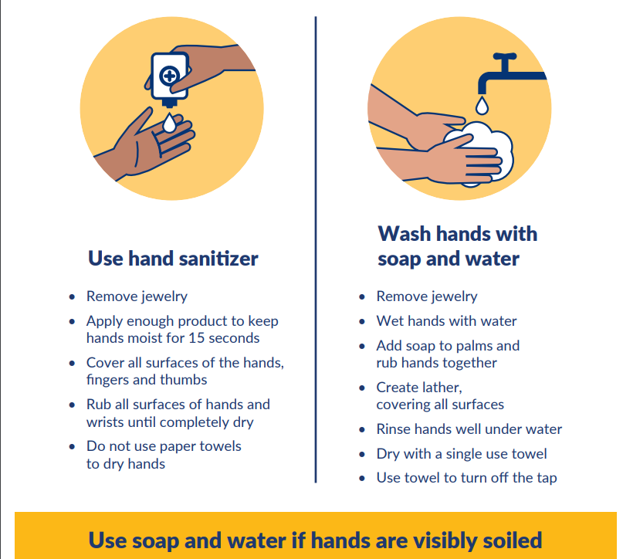
Hand Hygiene
How
Notes:
Presenter can review steps of hand sanitizer and hand washing and then show video on handwashing in next slide.

Slide 15
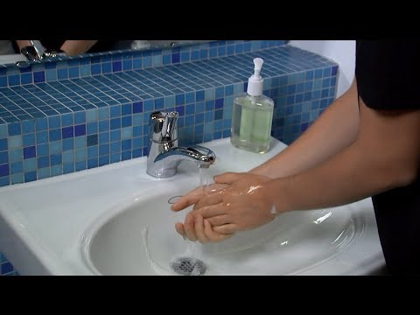
Hand Hygiene
How

Slide 16
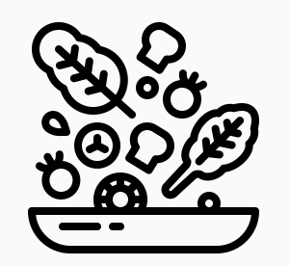

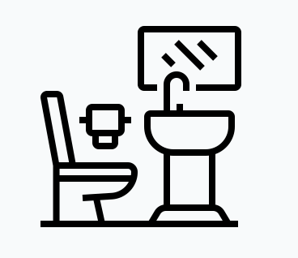

Hand Hygiene
When
Before eating or preparing food
After possible contamination (emptying/touching garbage, wiping nose, touching mask, contact with high touch objects)
After using washroom
After returning home

Slide 17



Hand Hygiene
Why
Prevents illnesses
Stops the spread of many infections

Slide 18
Handwashing Activity
See fake germs glow and how germs spread!
Participants instruct on how hand wash
Use UV light to see how the “germs” disappeared with handwashing!

Slide 19
Who remembers:
When to do hand hygiene?
Notes:
Ask participants to list times to do hand hygiene. Review on next slide.

Slide 20
Hand Hygiene
When
Before eating or preparing food
After possible contamination (emptying/touching garbage, wiping nose, touching mask, contact with high touch objects)
After using washroom
After returning home

Slide 21
Who remembers:
Why do we do hand hygiene?
Notes:
Ask participants to list times to do hand hygiene. Review on next slide.

Slide 22
Hand Hygiene
Why
Prevents illnesses
Stops the spread of many infections

Slide 23

Who has questions?
Who can share one new thing you learned today?

Slide 24

Thank you for participating!
Notes:
Put stickers in participants health promotion passports as a certification of completion.

