Slide 1

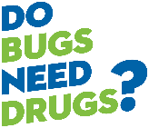

Beneficial Bacteria & Antibiotics
Healthy Living through Health Promotion
2025

Slide 2
Objectives for today’s activity
Identify two differences between bacteria and viruses
List two benefits of good bacteria in the body
Consider four risks of inappropriate antibiotic use
Have fun and play Bingo!

Slide 3
What do you know about bacteria and viruses?
Small group discussion
Notes:
Have 3-5 minute discussion with partners or small groups.

Slide 4
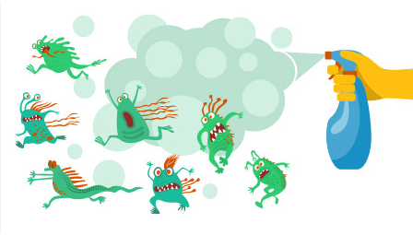
Bacteria and Viruses
Bacteria and Viruses are both “germs” but they are very different organisms
Marketing tells you that that all germs are bad
We do need to be careful of bacteria and viruses that cause infection
But, there are many bacteria in your body are good for you! (we’ll talk about this later)
Notes:
Participants may talk about fear of bacteria and germs. Validate participants that some bacteria do cause infections, and we need to be careful to wash hands and promote health. Bacteria and viruses are different organisms that can both cause sickness, but they need different treatments. Who has seen advertising that makes all bacteria seem bad?

Slide 5
What is an antibiotic?
Small group discussion
Notes:
Have 3-5 minute discussion with partners or small groups.

Slide 6
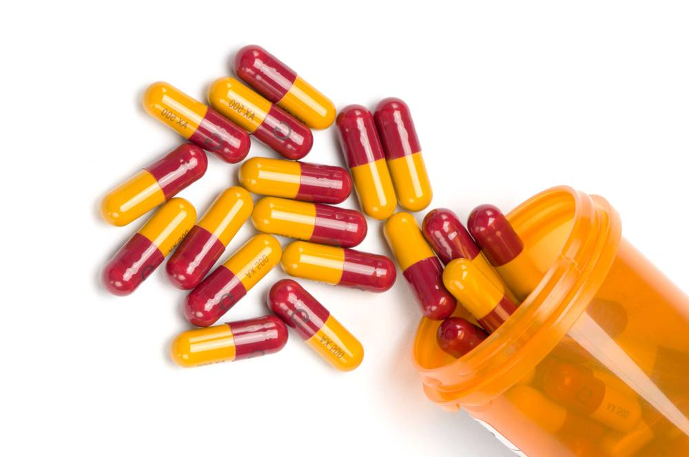
Antibiotics
Kill bacteria that cause bacterial infections
One of the most significant discoveries of modern medicine
Make modern medical procedures possible
Have saved millions of lives
Notes:
Antibiotics are a class of medicine to kill bacteria that cause bacterial infections. Our modern medical system relies on antibiotics for treatments and surgeries. Joint replacements, caesarean sections, organ transplant, burn therapy, and cancer therapy all rely on antibiotics.

Slide 7

Antibiotics
Do not work against viruses
Did you know: Colds, Influenza, and COVID-19 are all viruses – antibiotics aren’t needed!
Antibiotics
Notes:
Antibiotics do not have any effect on viruses. Did you know that most colds and flus are viruses? Viral infections such as colds, influenza, and COVID-19 don’t need antibiotics.

Slide 8
What are beneficial bacteria, or the microbiome?
Small group discussion
Notes:
3-5 min partner or small group discussion

Slide 9
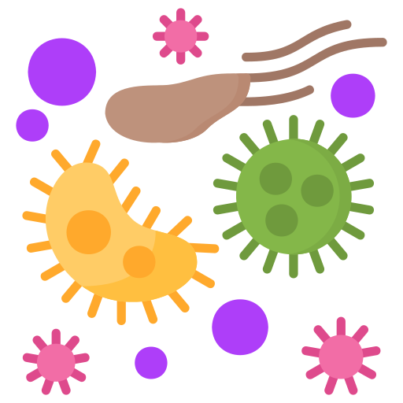
Beneficial (Good) Bacteria
Also called your “microbiome”
Do not cause infections
Live on your skin, in your mouth and intestines
Protect against disease causing bacteria
Image from Flaticon
Notes:
Beneficial bacteria are on your skin, in your mouth, nose, and digestive tract. They have many important benefits. One benefit is that they help digest your food. Another is that they crowd out infection causing bacteria and prevent infection. When you take an antibiotic, it kills the good bacteria along with the infection causing bacteria. Without the good bacteria taking up space, there is opportunity for infection causing bacteria to grow and take over. When antibiotics are needed, listen to your doctor and take them to kill the infection causing bacteria. When antibiotics aren’t needed, it is important to avoid them as they can disrupt your microbiome, or the good bacteria in your body.

Slide 10

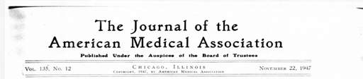
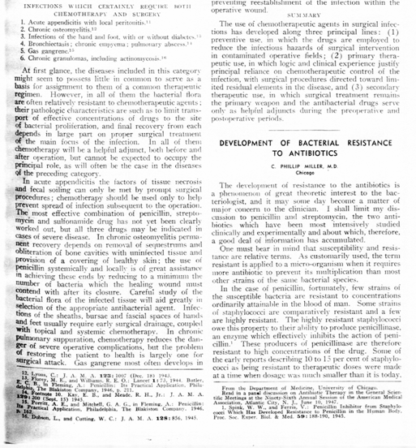
Notes:
Penicillin was discovered by Alexander Fleming in 1928 but was not widely used until World War II to treat war amputations and wounds, as shown in this World War II poster. The poster was to educate people on the new medicine and how it was helping the war effort.
Soon after antibiotics were introduced into medical practice, reports of antibiotic resistance began to emerge in the medical literature. Antibiotic resistance is when the bacteria change, and they are no longer killed by the medicine. Here is an early article about antibiotic resistance, which appeared in the Journal of the American Medical Association in 1947. Scientists and researchers found that bacteria that used to be killed by an antibiotic were no longer killed because the bacteria were changing. They termed this “antibiotic resistance” because the bacteria was resisting the effects of the antibiotic. Sometimes you hear the word superbug which means the bacteria is resistant to one or more antibiotics.

Slide 11
Antibiotic Resistance
Bacteria change and are no longer killed by the medicine that used to kill them
The more we use antibiotics, the more they can change and adapt a way to survive
Careful antibiotic use is important in preventing antibiotic resistance
Antibiotics should be used when needed for bacterial infections when a health care person recommends them

Slide 12

Antibiotic Resistance
Notes:
Here is a video that shows how antibiotic resistance happens. You can see that the bacteria change and evolve to survive. Avoiding antibiotics unless they are needed helps to save them for when we need them and for future generations.

Slide 13
Antibiotic Resistance
Resistance limits the effectiveness of antibiotics
The overuse and misuse of antibiotics increases resistance
Resistance can lead to infections being untreatable (superbugs)
Antibiotic resistance is a growing concern worldwide.
Notes:
Within a short time of antibiotics being available, it was discovered that bacteria can rapidly adapt and change, making themselves resistant to antibiotics. As new classes of antibiotics were discovered, bacteria also became resistant to these drugs.

Slide 14
Why should people be careful to only take antibiotics when they are prescribed to them?
Small group discussion
Notes:
3-5 min partner or small group discussion

Slide 15
Reasons to be careful about taking antibiotics
Antibiotics kill all bacteria (good and bad) and can disrupt your good bacteria (microbiome)
Antibiotics have side effects
Antibiotics can react with other medicine you are taking
Bacteria can develop antibiotic resistance
Notes:
Antibiotics kill all the bacteria (good and bad) so antibiotics disrupt your good bacteria (microbiome).
Antibiotics have side effects, so you want to avoid side effects when possible. Some side effects are more mild like loose stool and some are more serious, such as allergies or a medical complications that can cause severe harm or death. One example of this is when an antibiotic kills the good bacteria, a bacteria called C.difficile that may be in small numbers in your body, can grow and cause a serious infection or even death. If you don’t need an antibiotic, avoid it and the possible side effects!
It is possible for the antibiotic to have reactions with other medicine you are taking. If you don’t need the antibiotic, you can avoid the possible interactions too!
When bacteria are in the presence of antibiotics they can mutate or change so they are no longer killed by the antibiotic. This is called antibiotic resistance. When bacteria develop antibiotic resistance, the antibiotic no longer works and you can have an infection that is more difficult, or impossible, to treat. When you save antibiotics for when they are needed, you help preserve antibiotics for future infections to treat yourself and the next generation.

Slide 16
What are times that antibiotics may not be needed?
Small group discussion
Notes:
3-5 min partner or small group discussion

Slide 17
Times when an antibiotic is not needed
People should not take antibiotics without a prescription
No antibiotics are needed for viral infections (colds, flus, COVID-19)
The presence of bacteria in the urine without signs of infection can be normal – no antibiotic may be needed if the person has no symptoms of an infection
Testing urine without a reason leads to unnecessary antibiotic use
In some cases, an antibiotic may be prescribed prior to dental treatments, but many dental procedures don’t need antibiotics. Talk to your dentist.
Notes:
People should never take an antibiotic without a health care providers prescription. Do not take antibiotics prescribed to other people, and discard any leftover unused antibiotics at the pharmacy.
No antibiotics are needed for viral infections – colds, influenza, and COVID-19 are all viral infections.
The presence of bacteria found in urine cultures without signs and symptoms of sickness does not warrant an antibiotic. When you have bacteria in your urine without having signs of a sickness, it is called asymptomatic bacteriuria. Over age 80, 50% of women and 30% of men have bacteria in their urine but it is not causing an infection. Testing urine without a reason leads to unnecessary antibiotic use. When there are symptoms, try rehydration first. Only test urine when there is a medical reason.
In some cases an antibiotic may be prescribed prior to dental treatment. However, most simple extractions don’t need antibiotics. The best available evidence now shows that patients with prosthetic joints do not require antibiotics prior to dental care. There are still a small number of heart conditions for which antibiotics are recommended prior to care. Consult with your dentist and update them on any medical conditions or medications, recent surgeries, and/or changes to your health.

Slide 18

Symptom Free Pee: Let It Be
Stop: do not test foul-smelling, dark, or cloudy urine when there are no symptoms of sickness. No antibiotics are needed.
Wait: for changes in mood or behaviour, and monitor and rehydrate for 24 hours.
Go: when there are symptoms of concern, use urine culture.
Notes:
Unnecessary urine testing leads to unnecessary antibiotics. Up to 50% of women and 30% of men in older adulthood have bacteria in their urine without it causing sickness. Make sure you have signs of a sickness before testing urine.

Slide 19
What can I do to stay healthy?
Small group discussion
Notes:
3-5 min partner or small group discussion

Slide 20

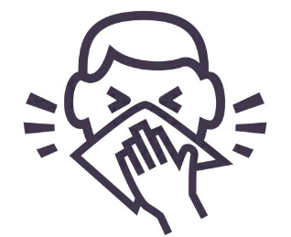

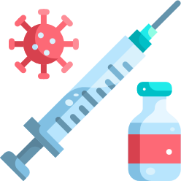
Ways to stay healthy and protect your microbiome
Frequent hand hygiene with plain soap and water or hand sanitizer
Cover coughs and sneezes with inner elbow or tissue
Dispose of tissues in the garbage and perform hand hygiene after disposal.
Wear a mask and practice distancing when indicated.
Stay up to date with immunizations (if you don’t get sick, you don’t need an antibiotic!)
Notes:
Beneficial bacteria are on your skin, in your mouth, nose, and digestive tract. They have many important benefits. One benefit is that they help digest your food. Another is that they crowd out infection causing bacteria and prevent infection. When you take an antibiotic, it kills the good bacteria along with the infection causing bacteria. Without the good bacteria taking up space, there is opportunity for infection causing bacteria to grow and take over. When antibiotics are needed, listen to your doctor and take them to kill the infection causing bacteria. When antibiotics aren’t needed, it is important to avoid them as they can disrupt your microbiome, or the good bacteria in your body.

Slide 21

What about “Probiotics”?
Probiotics are supplements that contain live bacteria.
Current research does not show that probiotic supplements on the market help the gut microbiome after antibiotics.
If your health care person recommends them, there could be benefit to you.
The best way to improve your microbiome after taking antibiotics is an improved diet, moderate exercise, and exposure to some microbes by being outside in nature or having pets.
Eating fibre from whole grains, fruits, and vegetables feeds the good bacteria in your body.
If you have questions, talk to your doctor.
Notes:
Reference: Éliás AJ, Barna V, Patoni C, et al. Probiotic supplementation during antibiotic treatment is unjustified in maintaining the gut microbiome diversity: a systematic review and meta-analysis. BMC Med. 2023;21(1):1-18. doi:10.1186/s12916-023-02961-0

Slide 22
Time for Bingo!
Notes:
Pass out bingo cards and pens/markers to participants.
Listen to the question and mark one box with the correct answer. Whoever has a line of five squares in any direction and first yells “BINGO” is the winner. Everyone can mark the free square now.
Hand out a prize to the winner.

Slide 23

Who has questions?
Who can share one new thing you learned today and how it will change your actions?

Slide 24

Thank you for participating!
Notes:
Put stickers in participants health promotion passports as a certification of completion.

