Slide 1

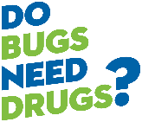

Antibiotic Resistance
A Closer Look at Bacteria and the Microbiome
Presentation for Grade 8 Students

Slide 2
Today we will learn:
The differences between bacteria and viruses, and their role in health and illness
How antibiotic resistance develops and why it’s a problem
How we can prevent the spread of infections
How YOU can prevent the spread of superbugs!
Notes:
Introduce yourselves and the agenda for the workshop.

Slide 3
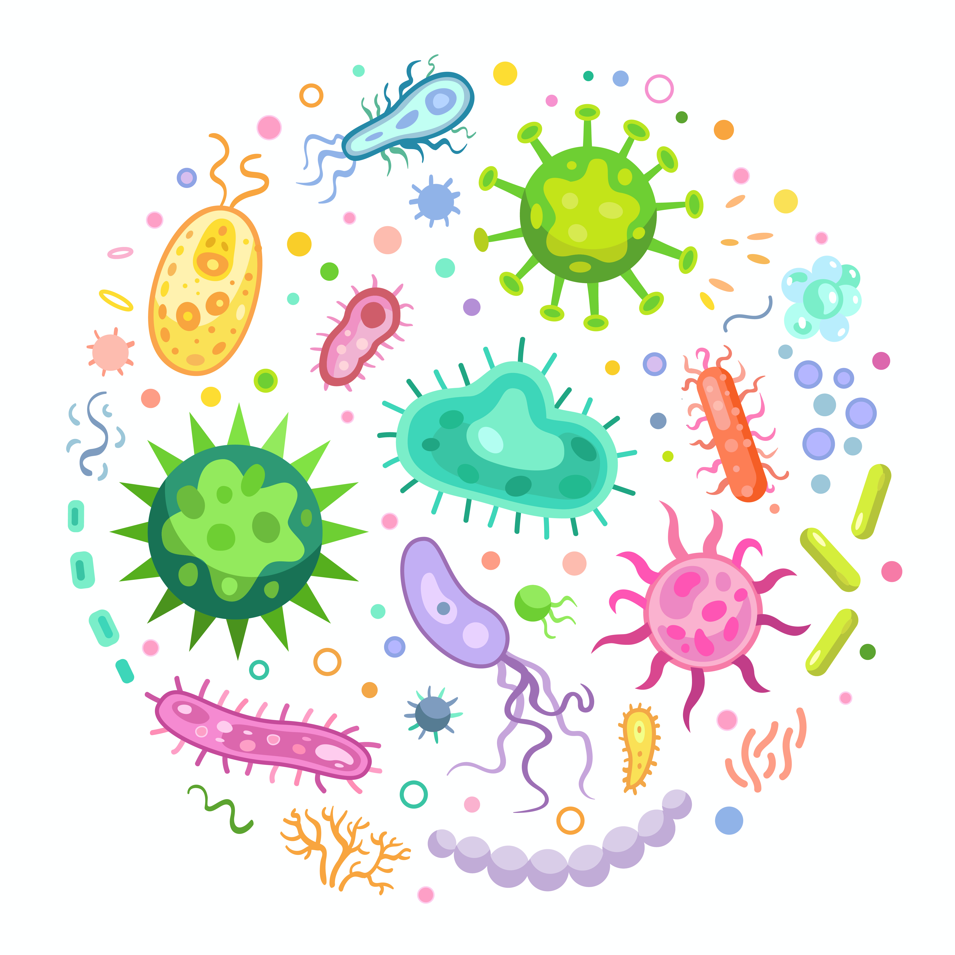
A Look Inside Our Microbiome
Your body contains 10-100 trillion micro-organisms!
This can include:
Helpful bacteria → commensals
  Help in digestion and nutrient absorption
  Compete with bad bacteria and protect you from infection
Harmful bacteria → pathogens
Viruses that can also be harmful
Bacteria and Viruses
Antibiotic Resistance
Illness Prevention
Notes:
This section starts with an introduction to the microbiome. Emphasize that bacteria can be helpful or harmful to humans. Helpful (or good) bacteria are called commensals. Harmful (or bad) bacteria are called pathogens

Slide 4


A Look Inside Our Microbiome
Viruses and bacteria can both cause illness in humans, but they are very different.
Bacteria and Viruses
Antibiotic Resistance
Illness Prevention

Slide 5
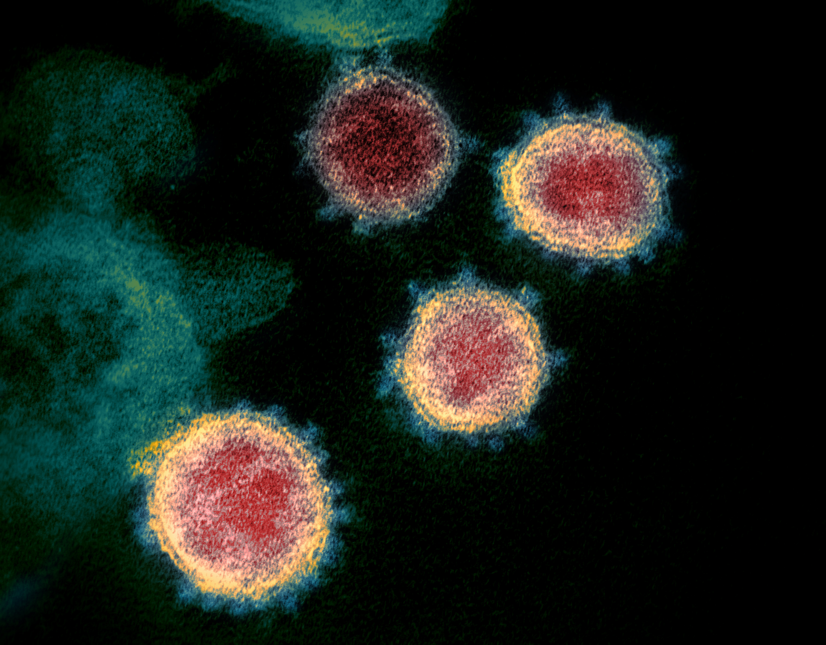
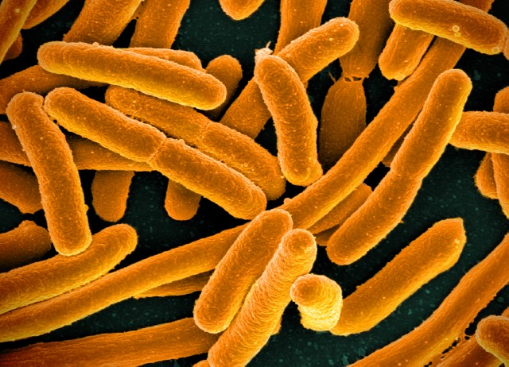
A Look Inside Our Microbiome
Bacteria and Viruses
Antibiotic Resistance
Illness Prevention
Notes:
Coronavirus (left), E. coli (bacteria) (right).
Viruses are much smaller than bacteria and they cannot replicate on their own. Bacteria have cell walls, can replicate (make copies) of themselves and they are larger than bacteria.

Slide 6
Activity 1: What are similarities and differences between bacteria and viruses?
Bacteria
Both
Viruses
Bacteria and Viruses
Antibiotic Resistance
Illness Prevention
Notes:
Brainstorm similarities and differences between bacteria and viruses
If students cannot think of answers, you can read out the following and ask students where each would go:
Cause illness (both)
Microscopic (both)
Living organism (bacteria)
Acellular, need to enter host cell to replicate (virus)
Can be killed by antibiotics (bacteria)
Can cause cold and flu (virus)

Slide 7
Illnesses caused by viruses | Illnesses caused by bacteria
Common cold Influenza (flu) Chicken pox HPV Most sore throats COVID-19 | Strep throat Tuberculosis Urinary tract infections (UTIs) Salmonella Pertussis (whooping cough)
Bacteria and Viruses
Antibiotic Resistance
Illness Prevention
Notes:
Before revealing the list, ask students if they can think of any illnesses caused by viruses? By bacteria?
Show the list of illnesses caused by bacteria vs. viruses.

Slide 8


What are antibiotics?
Medicines that are used to treat illnesses caused by bacteria.
Antibiotics are designed to attack the unique structures and machinery of bacterial cells.
Viruses are non-cellular, and have different structures and machinery than bacteria, so antibiotics cannot kill them.
Attack bacterial ribosomes
Attack bacterial cell wall
Bacteria and Viruses
Antibiotic Resistance
Illness Prevention
Notes:
Explain how antibiotics work. Ask students: you may have heard of the antibiotic penicillin. This antibiotic attacks the bacterial cell wall. Based on our discussion on the difference between bacteria and viruses, would penicillin work against viruses? Why?
Answer: No, because viruses do not have cell walls

Slide 9


Illnesses caused by viruses | Illnesses caused by bacteria
Common cold Influenza (flu) Laryngitis Chest colds (bronchitis) Most sore throats | Strep throat Tuberculosis Urinary tract infections (UTIs) Some types of pneumonia Pertussis
Do NOT use antibiotics
Can use antibiotics
Bacteria and Viruses
Antibiotic Resistance
Illness Prevention
Notes:
Key point: antibiotics are specifically designed to kill bacteria. They do not work against viruses. Antibiotics can only be used for the illnesses that are caused by bacteria.

Slide 10
What are the harms of using antibiotics when we don’t need them?
Overuse of antibiotics can lead to antibiotic resistance
(Optional) Watch this video on antibiotic resistance:
youtu.be/qDluMg9lqn8
Bacteria and Viruses
Antibiotic Resistance
Illness Prevention
Notes:
If time permits, the video to review what we have covered so far and introduce the concept of antibiotic resistance.

Slide 11



How does antibiotic resistance develop?
Bacteria mutate at random.
Bacteria and Viruses
Antibiotic Resistance
Illness Prevention
Notes:
Key point: antibiotic resistance is an example of natural selection, with antibiotic use driving this selection
What’s important to remember about antibiotic resistance is that it’s nothing to do with a person own immune system, it’s the bacteria in your body that are resistant.

Slide 12

How does antibiotic resistance develop?
Bacteria mutate at random.
Some bacteria can happen to develop a mutation that makes them resistant to antibiotics.
Bacteria and Viruses
Antibiotic Resistance
Illness Prevention
Notes:
Key point: antibiotic resistance is an example of natural selection, with antibiotic use driving this selection
What’s important to remember about antibiotic resistance is that it’s nothing to do with a person own immune system, it’s the bacteria in your body that are resistant.

Slide 13
How does antibiotic resistance develop?
Bacteria mutate at random.
Normally, good bacteria take up space in our body and prevent any resistant bacteria from taking over.
Some bacteria can happen to develop a mutation that makes them resistant to antibiotics.
Bacteria and Viruses
Antibiotic Resistance
Illness Prevention
Notes:
Key point: antibiotic resistance is an example of natural selection, with antibiotic use driving this selection
What’s important to remember about antibiotic resistance is that it’s nothing to do with a person own immune system, it’s the bacteria in your body that are resistant.

Slide 14

How does antibiotic resistance develop?
Bacteria mutate at random.
Normally, good bacteria take up space in our body and prevent any resistant bacteria from taking over.
When we use antibiotics, we kill susceptible (non-resistant) bacteria, but the resistant bacteria survive.
Some bacteria can happen to develop a mutation that makes them resistant to antibiotics.
Bacteria and Viruses
Antibiotic Resistance
Illness Prevention
Notes:
Key point: antibiotic resistance is an example of natural selection, with antibiotic use driving this selection
What’s important to remember about antibiotic resistance is that it’s nothing to do with a person own immune system, it’s the bacteria in your body that are resistant.

Slide 15
How does antibiotic resistance develop?
Bacteria mutate at random.
Normally, good bacteria take up space in our body and prevent any resistant bacteria from taking over.
When we use antibiotics, we kill susceptible (non-resistant) bacteria, but the resistant bacteria survive.
The resistant bacteria now have lots of space to grow and flourish.
Some bacteria can happen to develop a mutation that makes them resistant to antibiotics.
This is natural selection in action!
Bacteria and Viruses
Antibiotic Resistance
Illness Prevention
Notes:
Key point: antibiotic resistance is an example of natural selection, with antibiotic use driving this selection
What’s important to remember about antibiotic resistance is that it’s nothing to do with a person own immune system, it’s the bacteria in your body that are resistant.

Slide 16
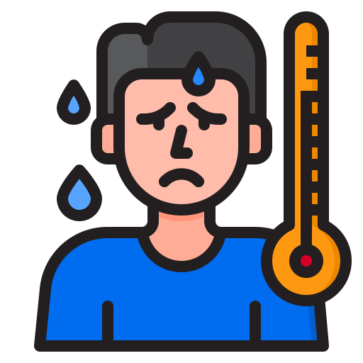
Activity 2
Terry is feeling sick. He found some antibiotics in his medicine cabinet. What could happen if:
  Terry took the leftover antibiotics and his illness was actually caused by a virus?
  Terry took the leftover antibiotics and his illness was actually caused by bacteria?
  Terry went to the doctor who gave him antibiotics to take?
Think about good bacteria, bad bacteria, and the risk of antibiotic resistance in each case
Bacteria and Viruses
Antibiotic Resistance
Illness Prevention
Notes:
Allocated time 7-10 minutes. Students can use the table in the worksheet to organize their thoughts. Once students regroup, ask students to share their answers.
If Terry took the antibiotics and his illness was actually caused by a virus
The good bacteria in his body will die
The virus will not die, so he will not feel better
There is a risk of antibiotic resistance, because once his good bacteria are killed, any resistant bacteria that survive will have more space to grow
If Terry took the antibiotics and his illness was actually caused by bacteria
The good bacteria in his body will die
The bad bacteria may or may not die: doctors prescribe specific antibiotics for specific bacteria. The infection that the old antibiotics were given for may be different than the infection that Terry has, so the old antibiotics might not work against Terry’s infection. Terry might not get better.
Key point: don’t use old antibiotics!
If Terry goes to the doctor, the doctor diagnosis him with a bacterial infection, and
the doctor prescribes him some antibiotics which he takes
The good bacteria in his body will die
Ask students: recall that a role of good bacteria is to help in digestion. What can happen when good bacteria die?
Key point: a common side effect of antibiotics is digestive issues.
However, by using antibiotics responsibly, we can make sure our good bacteria have a chance to recover
The bad bacteria will die and Terry will feel better
There is a still a risk of antibiotic resistance
Key point: there is a risk of resistance every time we use antibiotics, even if we’re using them correctly! It’s our job to use them responsibly so they work when we really need them. In this case, it was right for Terry to use antibiotics to treat his bacterial infection and get better.

Slide 17
How does antibiotic resistance spread?
Resistant bacteria can transfer their resistant gene to other bacteria through conjugation
Bacteria and Viruses
Antibiotic Resistance
Illness Prevention
Notes:
Key point: you can get antibiotic resistance even if you’ve never taken antibiotics, because it can spread from person to person. Antibiotic resistance isn’t only a problem for people who take lots of antibiotics – everyone is at risk. You can have antibiotic-resistant bacteria in your body even if you’ve never taken antibiotics and are young and healthy.

Slide 18

How does antibiotic resistance spread?
Resistant bacteria can transfer their resistant gene to other bacteria through conjugation
Bacteria and Viruses
Antibiotic Resistance
Illness Prevention
Notes:
Key point: you can get antibiotic resistance even if you’ve never taken antibiotics, because it can spread from person to person. Antibiotic resistance isn’t only a problem for people who take lots of antibiotics – everyone is at risk. You can have antibiotic-resistant bacteria in your body even if you’ve never taken antibiotics and are young and healthy.

Slide 19
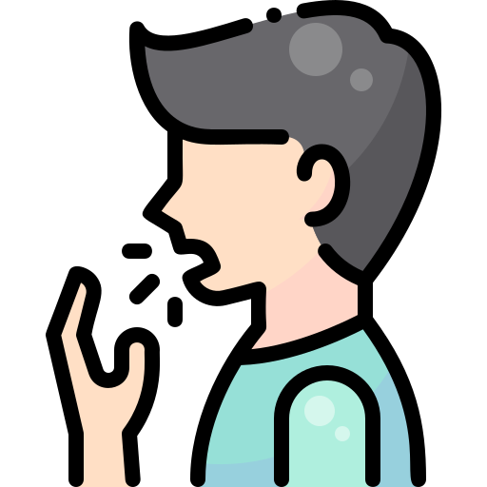

How does antibiotic resistance spread?
Resistant bacteria can transfer their resistant gene to other bacteria through conjugation
Spread from person to person
Bacteria and Viruses
Antibiotic Resistance
Illness Prevention
Notes:
Key point: you can get antibiotic resistance even if you’ve never taken antibiotics, because it can spread from person to person. Antibiotic resistance isn’t only a problem for people who take lots of antibiotics – everyone is at risk. You can have antibiotic-resistant bacteria in your body even if you’ve never taken antibiotics and are young and healthy.

Slide 20




Why is antibiotic resistance a problem?
The spread of antibiotic resistance means that the drugs that we normally use to treat infections no longer work.
Antibiotics are life-saving treatment in many situations:
Surgery
Childbirth
Transplant
Even small cuts and scrapes!
Bacteria and Viruses
Antibiotic Resistance
Illness Prevention
Notes:
Key point: antibiotic resistance is a life-saving medication!

Slide 21

How can we stop the spread of antibiotic resistance?
Every time we use antibiotics, we provide a selection pressure for bacteria to develop resistance.
It’s our job to limit our use of antibiotics, so that they work when we really need them.
This way, we can preserve antibiotics now and for the future
Bacteria and Viruses
Antibiotic Resistance
Illness Prevention

Slide 22


How can we preserve antibiotics?
Bacteria and Viruses
Antibiotic Resistance
Illness Prevention
Notes:
Have the class think of ideas. The next slides will review some answers.

Slide 23


How can we preserve antibiotics?
Prevent infections – if you don’t get sick, you don’t need antibiotics!
Bacteria and Viruses
Antibiotic Resistance
Illness Prevention

Slide 24


How can we preserve antibiotics?
Prevent infections – if you don’t get sick, you don’t need antibiotics!
When we do get sick, only use antibiotics if we need to – ask your doctor!
Bacteria and Viruses
Antibiotic Resistance
Illness Prevention

Slide 25
How can we preserve antibiotics?
?
Bacteria and Viruses
Antibiotic Resistance
Illness Prevention
Notes:
Ask students: what questions can you ask your doctor to make sure you are using antibiotics correctly?

Slide 26
How can we preserve antibiotics?
Do I have a bacterial infection
or a viral infection?
Do I need antibiotics?
Bacteria and Viruses
Antibiotic Resistance
Illness Prevention
Notes:
Other examples: how long do I need to take these antibiotics for? Do I have to take them with food?

Slide 27
How can we preserve antibiotics?
→ Prevent infections – if you don’t get sick, you don’t need antibiotics!
→ When we do get sick, only use antibiotics if we need to
Bacteria and Viruses
Antibiotic Resistance
Illness Prevention
Notes:
Use antibiotics wisely
Prevent illness – if you don’t get sick, you don’t need antibiotics
Use this as a transition to Part 3: Illness Prevention

Slide 28
Activity 3: Group Brainstorm
How can we prevent infections?
Bacteria and Viruses
Antibiotic Resistance
Illness Prevention
Notes:
Brainstorm ways to prevent infection. Comment that students have likely heard many strategies related to COVID-19 prevention, and many of these apply to illness prevention in general.

Slide 29
How can we prevent infections?
  Handwashing
  Stay home if sick
  Stay up to date on vaccinations
  Use antibiotics wisely
Bacteria and Viruses
Antibiotic Resistance
Illness Prevention

Slide 30
How can we prevent infections?
  Handwashing
  Stay home if sick, physical distance, masks
  Stay up to date on vaccinations
  Use antibiotics wisely
Bacteria and Viruses
Antibiotic Resistance
Illness Prevention

Slide 31

Handwashing
  Most common infections are spread by hands
Bacteria and Viruses
Antibiotic Resistance
Illness Prevention

Slide 32

Always dry your hands after washing!
  Removes more germs than washing alone
  Wet hands transmit germs more easily than dry hands
  Use paper towels or clean towels
Bacteria and Viruses
Antibiotic Resistance
Illness Prevention

Slide 33

Handwashing – soap vs. sanitizer?
Plain soap and water
Alcohol-based Sanitizer
Gets rid of bad bacteria and viruses
Good bacteria are not easily removed by handwashing
Need to dry hands!
No water required
Less drying time
Does not cause antibiotic resistance
Alcohol content should be over 60%
Not effective if hands greasy or dirty
Will kill good bacteria too
Bacteria and Viruses
Antibiotic Resistance
Illness Prevention

Slide 34
Avoiding antibacterial agents
Alcohol-based sanitizers and plain soap do not cause resistance
Some sanitizers and soaps have antibacterial agents:
  Triclosan
  Quarternary ammonium compounds or “Quats” – end in “nium” ex. Benzalkonium chloride, benzylammonium chloride
Can promote resistance
Can also remove good bacteria
Bacteria and Viruses
Antibiotic Resistance
Illness Prevention

Slide 35
Hand Hygiene - what to choose?
  ✓ Regular soap
  ✓ Alcohol based sanitizers
  Triclosan
  Quaternary ammonium compounds (Quats)
Avoid “antibacterial” soaps and sanitizers
Bacteria and Viruses
Antibiotic Resistance
Illness Prevention
Notes:
Soap and water and alcohol-based sanitizers can both be used for hand hygiene, but avoid antibacterial agents.

Slide 36
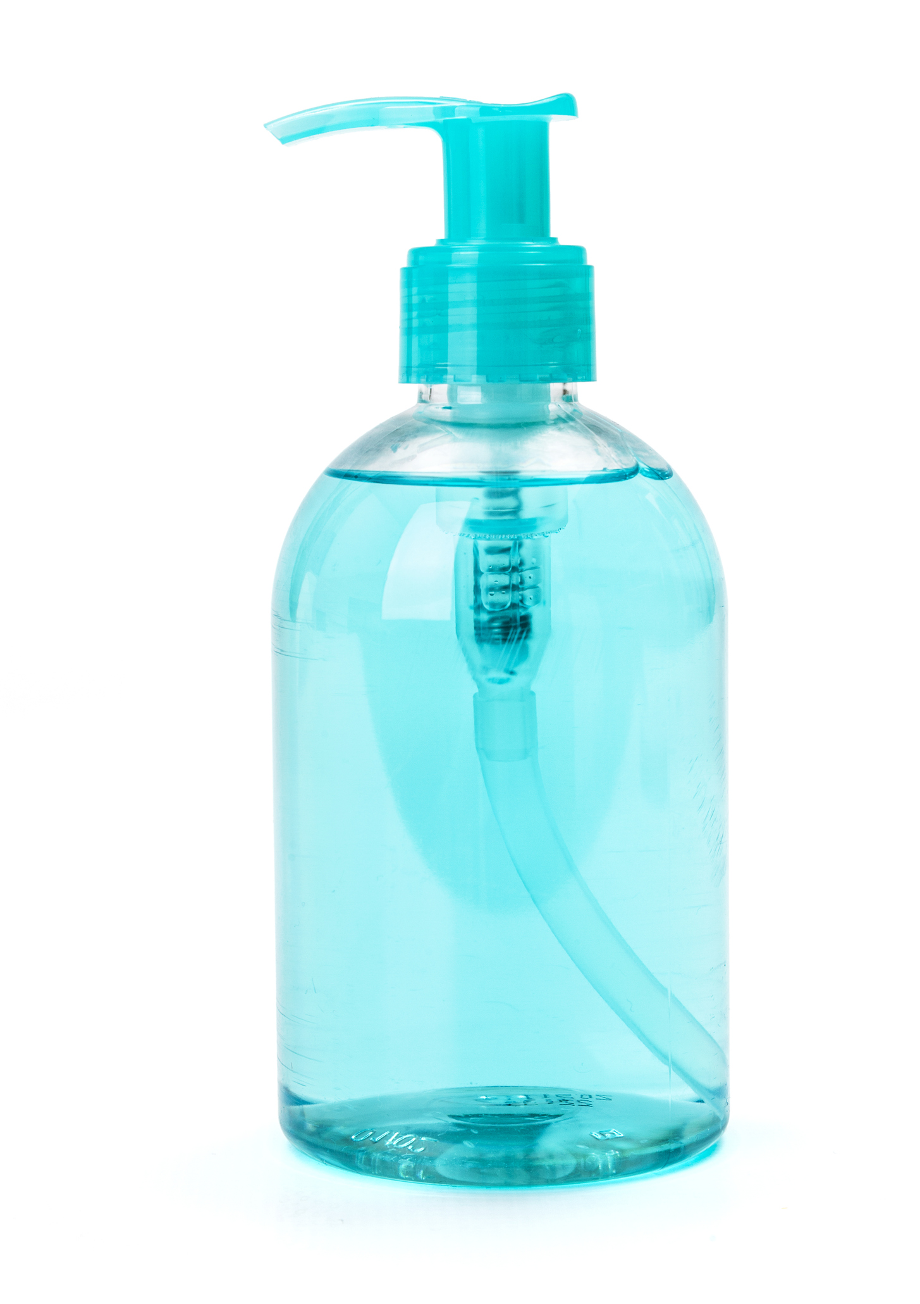
Antibacterial hand soap
Avoid contact with eyes. In case of contact, flush with water.
Ingredients: Aqua (Water), Sodium Lauryl Sulfate, Sodium Laureth Sulfate, Cocamidopropyl Betaine, Sodium Chloride, Cocamide MEA, Disodium Cocamido MIPA-Sulfosuccinate, Polyquaternium-7, Sorbitol, Glycerin, Propylene Glycol, Panthenol, Tocopherol Acetate, Fragrance, Triclosan, Cucumis Sativus (Cucumber) Fruit Extract, Equisetum Hiemale Extract, Salvia Officinalis (Sage) Leaf Extract, Thymus Vulgaris (Thyme) Extract, DMDM Hydantoin, Disodium EDTA.
ANTIBACTERIAL
HAND SOAP
Bacteria and Viruses
Antibiotic Resistance
Illness Prevention
Notes:
Pictures of soap ingredients: ask students to decide whether to avoid or use these agents. Soaps and sanitizers with triclosan or quats should be avoided.

Slide 37
Antibacterial hand soap
Avoid contact with eyes. In case of contact, flush with water.
Ingredients: Aqua (Water), Sodium Lauryl Sulfate, Sodium Laureth Sulfate, Cocamidopropyl Betaine, Sodium Chloride, Cocamide MEA, Disodium Cocamido MIPA-Sulfosuccinate, Polyquaternium-7, Sorbitol, Glycerin, Propylene Glycol, Panthenol, Tocopherol Acetate, Fragrance, Triclosan, Cucumis Sativus (Cucumber) Fruit Extract, Equisetum Hiemale Extract, Salvia Officinalis (Sage) Leaf Extract, Thymus Vulgaris (Thyme) Extract, DMDM Hydantoin, Disodium EDTA.
Triclosan
ANTIBACTERIAL
HAND SOAP
Quat
Bacteria and Viruses
Antibiotic Resistance
Illness Prevention
Notes:
Pictures of soap ingredients: ask students to decide whether to avoid or use these agents. Soaps and sanitizers with triclosan or quats should be avoided.
This products contains both triclosan and quats.

Slide 38
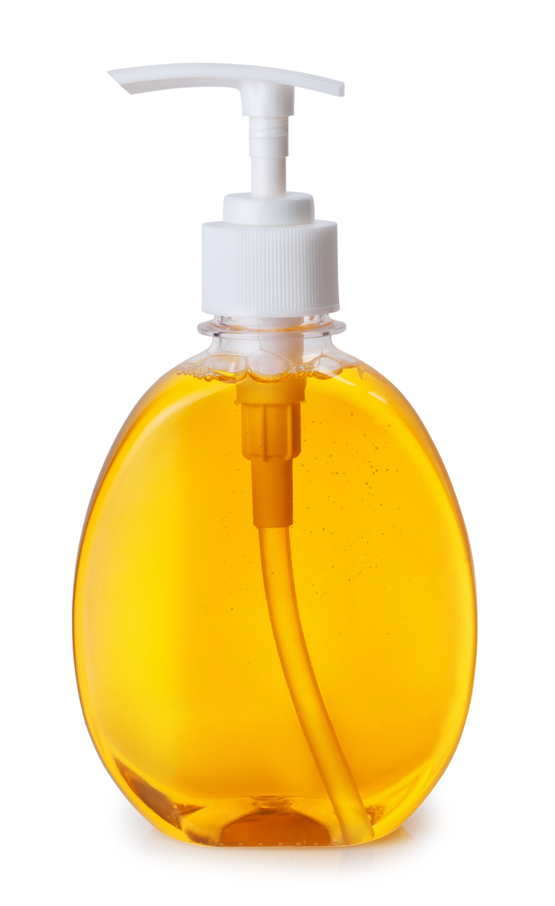
Plain soap
INGREDIENTS: AQUA (WATER), SODIUM LAURYL SULFATE, COCAMIDE DEA, COCAMIDOPROPYL BETAINE, GLYCERIN, ALOE BARBADENSIS GEL, TOCOPHERYL ACETATE (VITAMIN E), CITRIC ACID, SODIUM CHLORIDE, SODIUM CITRATE, BENZOPHENONE-4, METHYLCHLORO-ISOTHIAZOLINONE, METHYLISO-THISZOLINONE, PARFUM (FRAGRANCE), EXT. VIOLET 2.
Foaming
Hand Soap
With Vitamin E + Aloe
Naturally derived
Triclosan-free
Bacteria and Viruses
Antibiotic Resistance
Illness Prevention
Notes:
38

Slide 39
Plain soap
No Quats
INGREDIENTS: AQUA (WATER), SODIUM LAURYL SULFATE, COCAMIDE DEA, COCAMIDOPROPYL BETAINE, GLYCERIN, ALOE BARBADENSIS GEL, TOCOPHERYL ACETATE (VITAMIN E), CITRIC ACID, SODIUM CHLORIDE, SODIUM CITRATE, BENZOPHENONE-4, METHYLCHLORO-ISOTHIAZOLINONE, METHYLISO-THISZOLINONE, PARFUM (FRAGRANCE), EXT. VIOLET 2.
Foaming
Hand Soap
With Vitamin E + Aloe
Naturally derived
Triclosan-free
No Triclosan
Bacteria and Viruses
Antibiotic Resistance
Illness Prevention
Notes:
This brand is not labeled antibacterial, and actually states on the front that it is triclosan-free. The ingredient list does not contain triclosan or quats.
This product is OK.
39

Slide 40
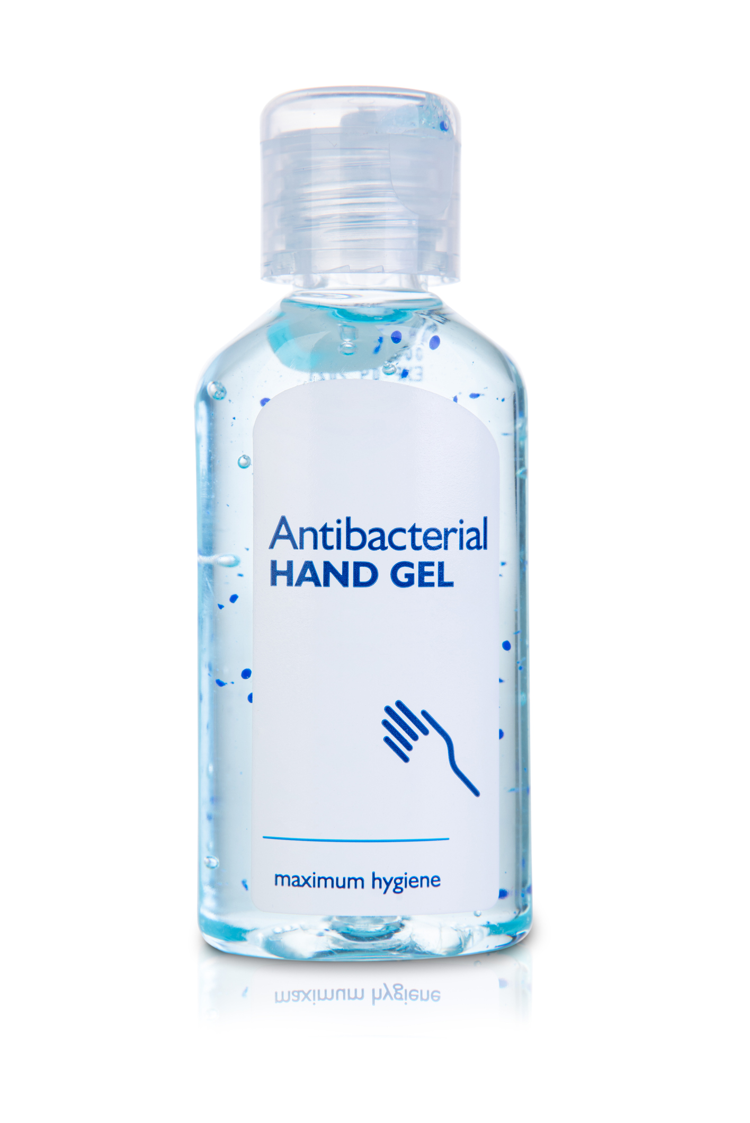
Alcohol based hand sanitizer
ACTIVE INGREDIENT: Denatured ethanol 62% w/w OTHER INGREDIENTS: Aqua, Oleth-20, Carbomer, Parfum, Aminomethyl-propanol, Aloe Barbadensis Leaf Extract
Gel Hand
Sanitizer
Bacteria and Viruses
Antibiotic Resistance
Illness Prevention
Notes:
40

Slide 41
Alcohol based hand sanitizer
ACTIVE INGREDIENT: Denatured ethanol 62% w/w OTHER INGREDIENTS: Aqua, Oleth-20, Carbomer, Parfum, Aminomethyl-propanol, Aloe Barbadensis Leaf Extract
Alcohol
Gel Hand
Sanitizer
Make sure the hand sanitizer does not contain triclosan or quats. Some alcohol-based hand sanitizers do.
Bacteria and Viruses
Antibiotic Resistance
Illness Prevention
Notes:
This is an alcohol based hand sanitizer. It contains 62% alcohol as well as other ingredients that protect the skin against the drying effects of the alcohol. This product is OK because the alcohol percentage is over 60%
41

Slide 42
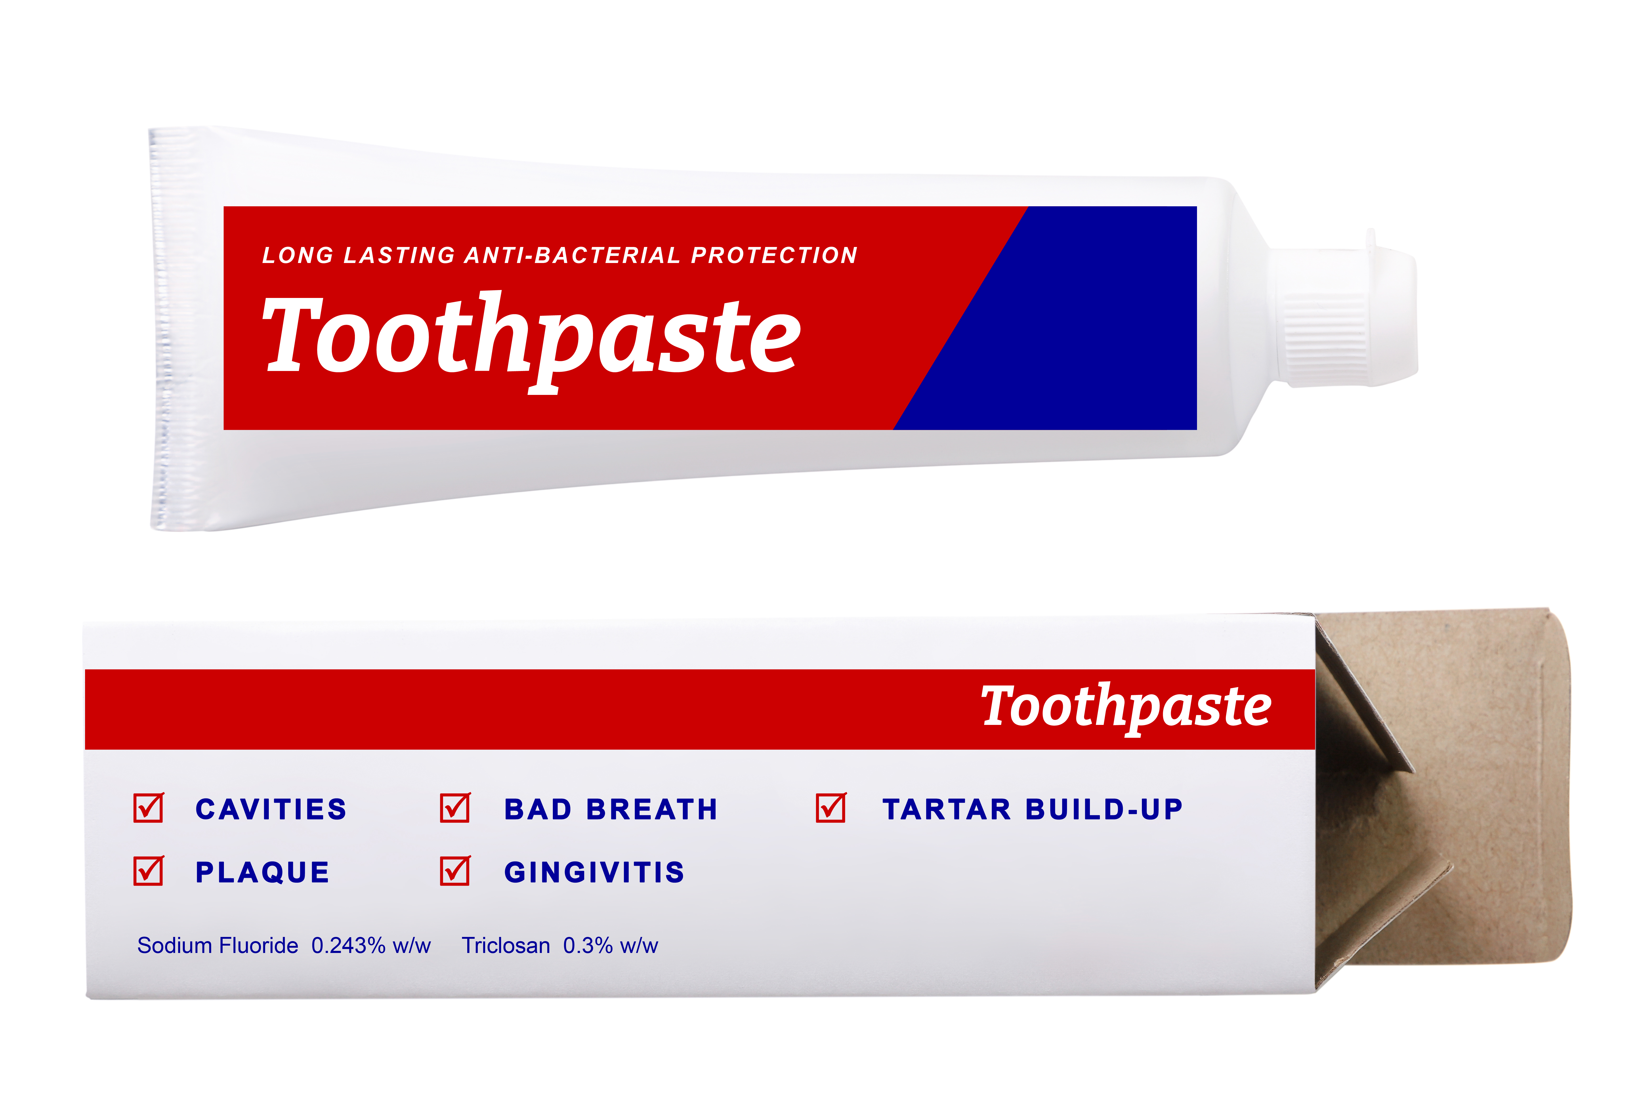
Antibacterial toothpaste
Bacteria and Viruses
Antibiotic Resistance
Illness Prevention
Notes:
Triclosan not only shows up in cleaning products, but in personal care items like toothpaste. Here’s an example.
42

Slide 43
Antibacterial toothpaste
Regular toothpaste should have no triclosan in the ingredients.
Triclosan
Bacteria and Viruses
Antibiotic Resistance
Illness Prevention
Notes:
This product contains triclosan. We could make a different choice to have a toothpaste that does not contain triclosan.
43

Slide 44
How can we prevent infections?
  Handwashing
  Stay home if sick, physical distance, masks
  Stay up to date on vaccinations
  Use antibiotics wisely
Bacteria and Viruses
Antibiotic Resistance
Illness Prevention

Slide 45
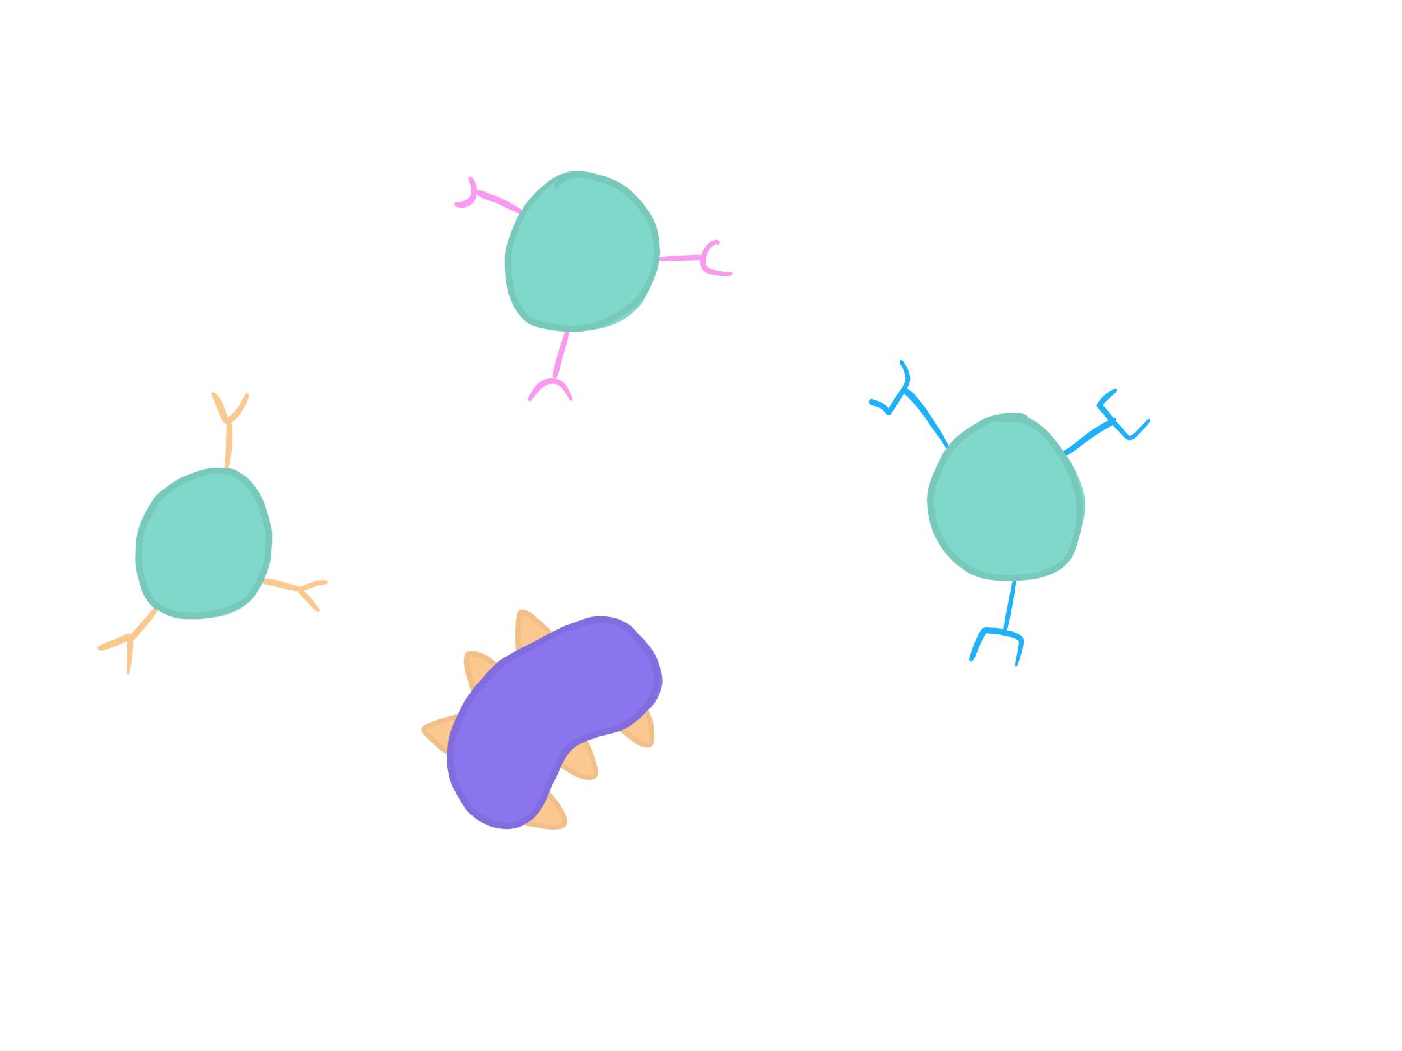
Vaccines: Prepping the Immune System
    Your immune system can learn – once you’ve been infected by a pathogen, it remembers how to destroy it
Bacteria and Viruses
Antibiotic Resistance
Illness Prevention
Notes:
Students learn about the immune system in Science 8
Build on this knowledge by explaining that vaccines prepare the immune system by introducing a harmless version of the pathogen

Slide 46
Vaccines: Prepping the Immune System
    Your immune system can learn – once you’ve been infected by a pathogen, it remembers how to destroy it
Bacteria and Viruses
Antibiotic Resistance
Illness Prevention
Notes:
Students learn about the immune system in Science 8
Build on this knowledge by explaining that vaccines prepare the immune system by introducing a harmless version of the pathogen

Slide 47

Vaccines: Prepping the Immune System
    Your immune system can learn – once you’ve been infected by a pathogen, it remembers how to destroy it
Bacteria and Viruses
Antibiotic Resistance
Illness Prevention
Notes:
Students learn about the immune system in Science 8
Build on this knowledge by explaining that vaccines prepare the immune system by introducing a harmless version of the pathogen

Slide 48
Vaccines: Prepping the Immune System
    The next time you’re exposed to that pathogen,
your immune system can quickly destroy it before you get sick
    Your immune system can learn – once you’ve been infected by a pathogen, it remembers how to destroy it
Bacteria and Viruses
Antibiotic Resistance
Illness Prevention
Notes:
Students learn about the immune system in Science 8
Build on this knowledge by explaining that vaccines prepare the immune system by introducing a harmless version of the pathogen

Slide 49


Vaccines: Prepping the Immune System
    Vaccines contain an inactive pathogen or part of a pathogen
Bacteria and Viruses
Antibiotic Resistance
Illness Prevention

Slide 50
Vaccines: Prepping the Immune System
    Vaccines contain an inactive pathogen or part of a pathogen
Bacteria and Viruses
Antibiotic Resistance
Illness Prevention

Slide 51
Vaccines: Prepping the Immune System
    Vaccines contain an inactive pathogen or part of a pathogen
Bacteria and Viruses
Antibiotic Resistance
Illness Prevention
Notes:
Your immune system can build protection against that type of infection without having to get sick with the infection!

Slide 52
Vaccines: Prepping the Immune System
    Vaccines contain an inactive pathogen or part of a pathogen
    Vaccines help your immune system learn without having to get sick first.
If you get exposed, your immune system is ready to protect you
Bacteria and Viruses
Antibiotic Resistance
Illness Prevention

Slide 53
Vaccines: Prepping the Immune System
  There are vaccines that prevent bacterial infections, such as pneumonia and meningitis
  Other vaccines prevent against viral infections (ex. HPV, COVID-19)
  Routine vaccinations are given in Grade 9
Bacteria and Viruses
Antibiotic Resistance
Illness Prevention
Notes:
There are vaccines that can help prevent us from getting sick with viruses like HPV or COVID-19 and there are vaccines that help protect us against bacteria that cause illness like meningitis or pertussis. Beyond preventing the illnesses they are created to protect us against, immunization also helps to prevent antimicrobial resistance because if there are less illnesses then there is less of a chance antibiotics will be used incorrectly or for the wrong reasons.
The meningococcal quadrivalent conjugate vaccine and Tdap vaccine are offered to all students in grade 9.

Slide 54
How can we prevent infections?
  Handwashing
  Stay home if sick, physical distance, masks
  Stay up to date on vaccinations
  Use antibiotics wisely
Bacteria and Viruses
Antibiotic Resistance
Illness Prevention

Slide 55
What we learned today
That bacteria and viruses are different. They both can cause illness but only bacterial illnesses can be treated with antibiotics
Use antibiotics wisely. Bacteria can become resistant to antibiotics, so ask your doctor how to appropriately use antibiotics when they are prescribed to you
By preventing illness, we can minimize antibiotic use and stop the spread of superbugs

Slide 56
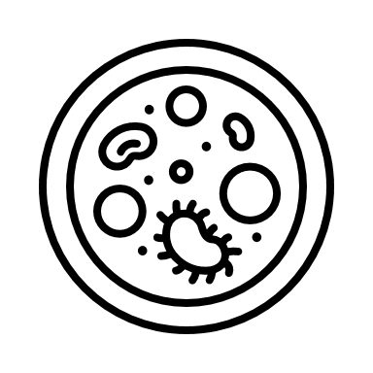
Questions?

Slide 57
Thank you!

Slide 58
Images used
Free for use images via flaticon.com by users: Freepik, Smashicons, Vitaly Gorbochev, Smalllikeart, Darius Dan, Srip, Geotatah
Microscopic images from Wikimedia Commons

