Slide 1



Immunizations for Adults
Healthy Living through Health Promotion
2025

Slide 2
Objectives for today’s activity
List three reasons why it is important for adults to get vaccinated
Recognize three diseases that you can protect against with vaccines
Indicate where you can get more information on vaccines

Slide 3


Let’s start with a game!
I will ask some questions:
Give a thumbs up if you think the statement is true
Give a thumbs down if you think the statement is false
Notes:
We will go through 5 true or false questions and you can give your best guess if the statement is true or false. If you think it is true, give a thumbs up, if you think it is false, give a thumbs down.

Slide 4
Question 1
True/False Questions
Getting sick is the only way to develop immunity (be protected from) a disease.
Thumbs up for TRUE
Thumbs down for FALSE
Notes:
Read the question aloud to the participants. Remind participants to use thumbs up if they think it’s true and thumbs down if they think it is false.
The answer will appear when you click the mouse or right arrow on the keyboard.

Slide 5
Question 1
True/False Questions
Getting sick is the only way to develop immunity (be protected from) a disease.
Answer
False: You don’t have to experience an infectious disease to develop immunity, you can get vaccinated. Immunization is the safest way to build immunity. Getting the disease can put you and others around you at risk for severe illness, and in some cases, long term disability or death.
Thumbs up for TRUE
Thumbs down for FALSE
Notes:
Read the question aloud to the participants. Remind participants to use thumbs up if they think it’s true and thumbs down if they think it is false.
The answer will appear when you click the mouse or right arrow on the keyboard.

Slide 6
Question 2
True/False Questions
If the children in the family are vaccinated, the adults and grandparents don’t need to worry about getting vaccines.
Thumbs up for TRUE
Thumbs down for FALSE
Notes:
Read the question aloud to the participants. Remind participants to use thumbs up if they think it’s true and thumbs down if they think it is false.
The answer will appear when you click the mouse or right arrow on the keyboard.

Slide 7
Question 2
True/False Questions
If the children in the family are vaccinated, the adults and grandparents don’t need to worry about getting vaccines.
Answer
False: Both children and adults need immunizations to protect themselves and their family from disease. Even if you were fully immunized as a child, protection can wear off over time and you may need a booster. There are also some immunizations that are first recommended in adulthood.
Thumbs up for TRUE
Thumbs down for FALSE
Notes:
Read the question aloud to the participants. Remind participants to use thumbs up if they think it’s true and thumbs down if they think it is false.
The answer will appear when you click the mouse or right arrow on the keyboard.

Slide 8
Question 3
True/False Questions
When you have a disease, it can be harder for your body to fight off an infection.
Thumbs up for TRUE
Thumbs down for FALSE
Notes:
Read the question aloud to the participants. Remind participants to use thumbs up if they think it’s true and thumbs down if they think it is false.
The answer will appear when you click the mouse or right arrow on the keyboard.

Slide 9
Question 3
True/False Questions
When you have a disease, it can be harder for your body to fight off an infection.
Answer
True: If you have a health condition it may be harder for your body to fight off an infection, so it is especially important to get immunized. Talk to your health care provider if you have questions.
Thumbs up for TRUE
Thumbs down for FALSE
Notes:
Read the question aloud to the participants. Remind participants to use thumbs up if they think it’s true and thumbs down if they think it is false.
The answer will appear when you click the mouse or right arrow on the keyboard.

Slide 10
Question 4
True/False Questions
The more people are vaccinated, the fewer opportunities a disease has to spread.
Thumbs up for TRUE
Thumbs down for FALSE
Notes:
Read the question aloud to the participants. Remind participants to use thumbs up if they think it’s true and thumbs down if they think it is false.
The answer will appear when you click the mouse or right arrow on the keyboard.

Slide 11
Question 4
True/False Questions
The more people are vaccinated, the fewer opportunities a disease has to spread.
Answer
True: When a community has high vaccination rates, diseases don’t have the opportunity to spread. This is important as it protects babies who are too young to be vaccinated, and people who may not be able to be vaccinated, like those going through cancer treatments.
Thumbs up for TRUE
Thumbs down for FALSE
Notes:
Read the question aloud to the participants. Remind participants to use thumbs up if they think it’s true and thumbs down if they think it is false.
The answer will appear when you click the mouse or right arrow on the keyboard.

Slide 12
Question 5
True/False Questions
It is recommended to get the flu vaccine once every five years.
Thumbs up for TRUE
Thumbs down for FALSE
Notes:
Read the question aloud to the participants. Remind participants to use thumbs up if they think it’s true and thumbs down if they think it is false.
The answer will appear when you click the mouse or right arrow on the keyboard.

Slide 13
Question 5
True/False Questions
It is recommended to get the flu vaccine once every five years.
Answer
False: It is recommended to get the flu vaccine every year in the fall. The influenza virus changes from year to year, and your body needs the booster for protection.
Thumbs up for TRUE
Thumbs down for FALSE
Notes:
Read the question aloud to the participants. Remind participants to use thumbs up if they think it’s true and thumbs down if they think it is false.
The answer will appear when you click the mouse or right arrow on the keyboard.

Slide 14
Did any of the true/false answers surprise you?
Small group discussion
Notes:
Have 3-5 minute discussion with partners or small groups.

Slide 15
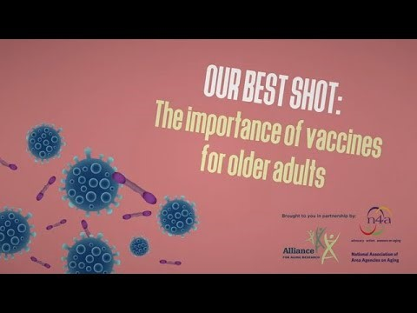
Video: The Importance of Vaccines for Older Adults
Watch until 3:00 minutes.
Notes:
Here is a video explaining the importance of vaccines for older adults. https://www.youtube.com/watch?v=hodb65EkorM
You can see that the bacteria change and evolve to survive. It has nothing to do with a person’s immune system as it is the bacteria that are changing. Avoiding antibiotics unless they are needed helps to save them for when we need them and for future generations.

Slide 16
Which reason to be vaccinated stood out to you the most?
Small group discussion
Notes:
Have 3-5 minute discussion with partners or small groups.

Slide 17
Which vaccines are recommended for adults?
Activity
Hand out the matching activity sheets
Each person (or small group) can try to match the vaccine to the symptoms of the disease it protects against.
After everyone has matched, review the correct answers with the group.
Notes:
Read instructions and hand out cards (Appendix F in lesson plan).
Leave time for participants to match symptoms with vaccine that prevents against the disease
Review correct answers as needed.
Reinforce that there are vaccines for each of these diseases and that getting the immunization is much safer than getting the disease
Note that not all vaccine preventable diseases recommended for adults are mentioned in this activity, so participants should talk to their health care provider about which vaccines are recommended for them.

Slide 18
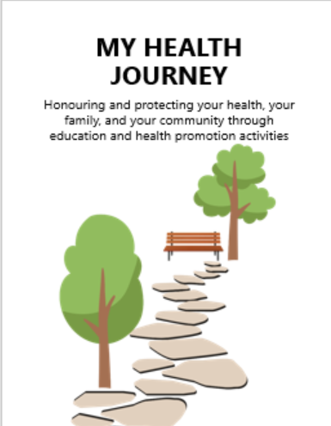
Where can I find more information on vaccines?
Review Health Journey Booklet as a group
Notes:
Look at last page with where you can find more information on vaccines, and look at vaccine history chart to start talking to HCP about filling out.

Slide 19
Remember to review your vaccine history with your health care provider
Notes:
Over time if your medical condition changes, or if you are taking certain medications or treatments, you may be recommended additional vaccines. Make sure to talk with your health care provider about protecting yourself and your loved ones by staying up to date with vaccines.

Slide 20

Who has questions?
Who can share one new thing you learned today and how it will change your actions?

Slide 21

Thank you for participating!
Notes:
Put stickers in participants health promotion passports as a certification of completion.

